Slide 1
Sedimentary Rocks
Earth and Space Science

Slide 2
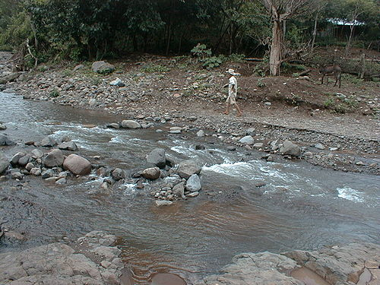
Sedimentary Rock
Rock formed from sediment being compressed and
cemented together
Rocks break down due
to weathering
Weathering – change in
physical form or chemical
composition of rocks on
the Earth’s surface
- Weathering agents → wind, rain, rockslides, acid rain, ice
- These can break up rocks into smaller pieces called sediment

Slide 3
Sedimentary Rock
- Sediment – small pieces or fragments of weathered rock
- Wide range of sizes of particles
→ Smaller than sand to larger than a car
→ Generally pebble size and smaller is
meant by the term sediment

Slide 4
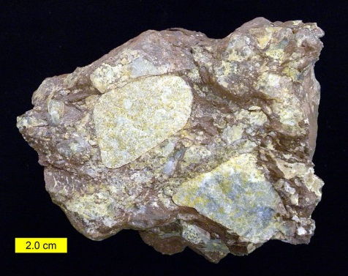
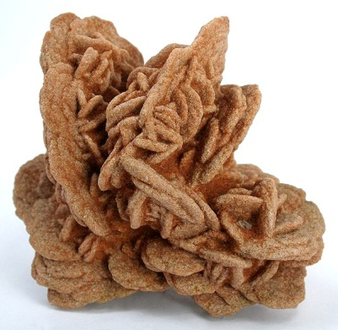
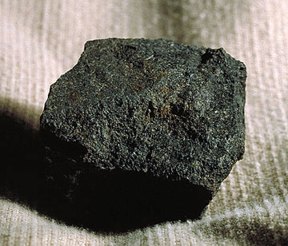
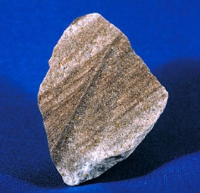
Sedimentary Rock
- Sedimentary rock is “recycled rock” → contains fragments of other rocks and remains that are “glued” together
- How does it happen?
→ There are 2 ways loose sediment becomes a rock
1. Sediment forms layers on top of layers that become compressed over time to form rock due to the weight pushing down from above
2. Dissolved minerals seep into the cracks and “glue” pieces of rock together

Slide 5
Sedimentary Rock
- Sedimentary rocks are named by their particle size
Name - Particle Size
Conglomerate - Pebble size
Sandstone - Sand size
Mudstone / Shale - Silt size / very fine
Limestone - Made of broken
fragments of once living
sea creatures (shells
mainly) or Deposits of
Calcium Carbonate

Slide 6
Sedimentary Rocks video
Sedimentary rocks

Slide 8
Sedimentary Rocks
3
Rocks From Surface Materials
Rock is a consolidated mixture of minerals. Some of these minerals could be in bits and pieces of other rocks. Such small bits and pieces are called clasts.
Rocks inside Earth are protected from surface conditions.
Rock exposed at the surface is attacked by the weather.

Slide 9
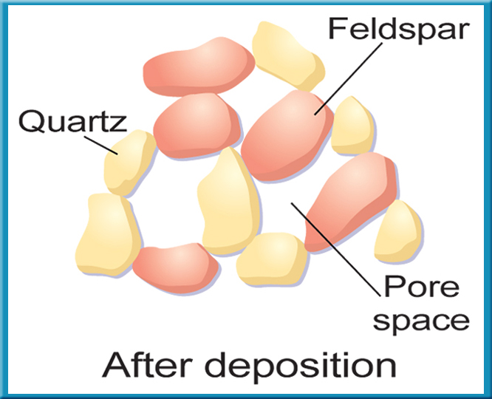
Sedimentary Rocks
3
Transportation and Deposition
Mechanical weathering processes break into smaller clasts.
When clasts are transported to new locations, they often become rounded before being deposited.
When clasts are loose on Earth’s surface, they don’t fit together perfectly. The empty space in between the grains is called porosity.

